Slide 1
INTERFACING AND COMMUNICATION
UNIT V

Slide 2
Input/Output Problems
Wide variety of peripherals
—Delivering different amounts of data
—At different speeds
—In different formats
All slower than CPU and RAM
Need I/O modules

Slide 3
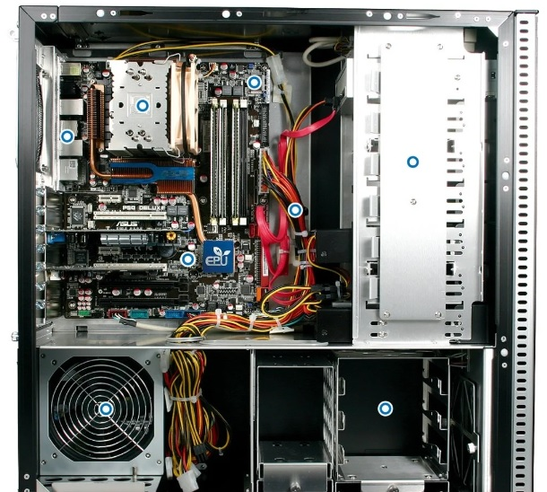
Input/Output Module
Interface to CPU and Memory
Interface to one or more peripherals

Slide 4
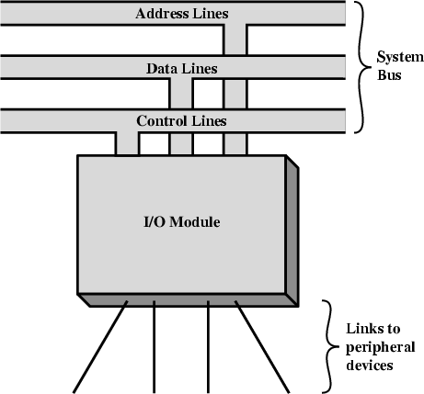
Generic Model of I/O Module

Slide 5
External Devices
Human readable
—Screen, printer, keyboard
Machine readable
—Monitoring and control
Communication
—Modem
—Network Interface Card (NIC)

Slide 6
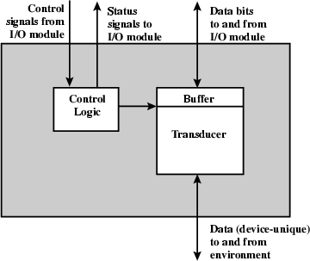
External Device Block Diagram

Slide 7
I/O Module Function
Control & Timing
CPU Communication
Device Communication
Data Buffering
Error Detection

Slide 8
I/O Steps( Transfer Data from External Device)
CPU checks I/O module device status
I/O module returns status
If ready, CPU requests data transfer
I/O module gets data from device
I/O module transfers data to CPU
Variations for output, DMA, etc.

Slide 9
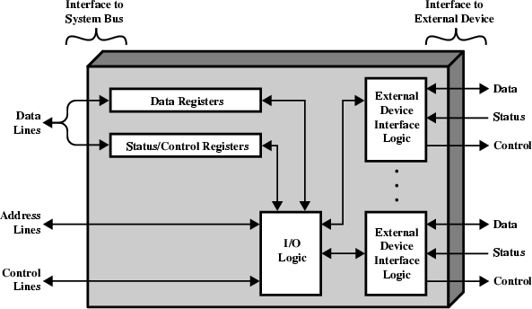
I/O Module Diagram

Slide 10
I/O Module Decisions
Hide or reveal device properties to CPU(Example: timing , formats, electromechanics)
Support multiple or single device
Control device functions or leave for CPU
Also O/S decisions
—e.g. Unix treats everything it can as a file

Slide 11
Input Output Techniques
Programmed
Interrupt driven
Direct Memory Access (DMA)

Slide 12
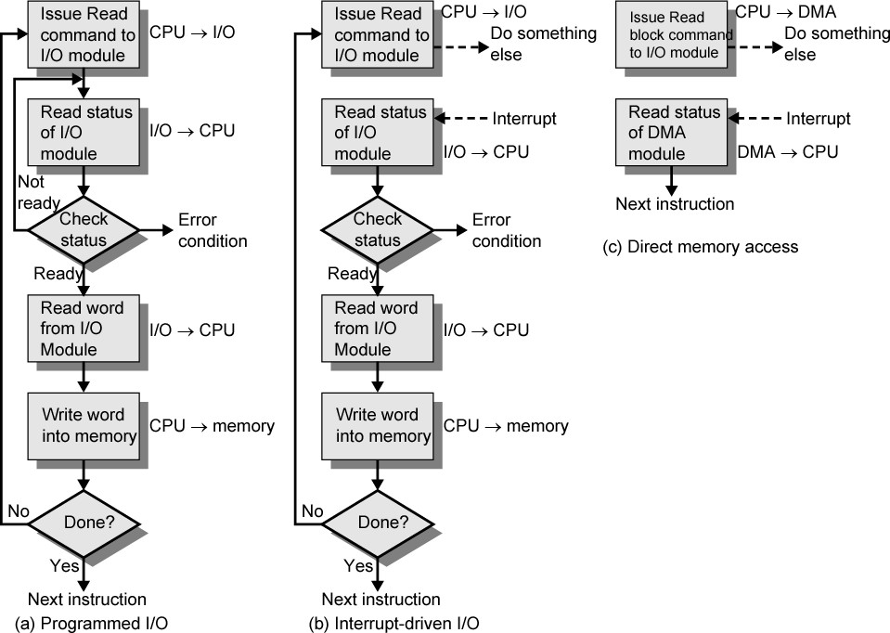
Three Techniques for Input of a Block of Data

Slide 13
Programmed I/O
CPU has direct control over I/O
—Sensing status
—Read/write commands
—Transferring data
CPU waits for I/O module to complete operation
Wastes CPU time

Slide 14
Programmed I/O - detail
CPU requests I/O operation
I/O module performs operation
I/O module sets status bits
CPU checks status bits periodically
I/O module does not inform CPU directly
I/O module does not interrupt CPU
CPU may wait or come back later

Slide 15
I/O Commands
CPU issues address
—Identifies module (& device if >1 per module)
CPU issues command
—Control - telling module what to do
e.g. spin up disk
—Test - check status
e.g. power? Error?
—Read/Write
Module transfers data via buffer from/to device

Slide 16
Addressing I/O Devices
Under programmed I/O data transfer is very like memory access (CPU viewpoint)
Each device given unique identifier
CPU commands contain identifier (address)

Slide 17
I/O Mapping
Memory mapped I/O
— I/O Devices and memory share an same address space
— I/O looks just like memory read/write
— No special commands for I/O
Large selection of memory access commands available
Isolated I/O (port-mapped I/O )
— Separate address spaces
— Need I/O or memory select lines
— Special commands for I/O
Limited set

Slide 18
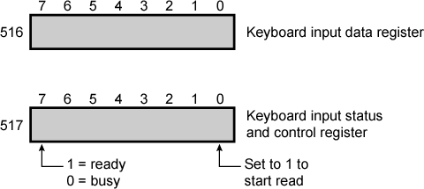
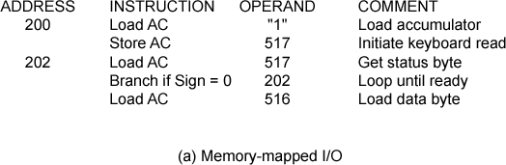
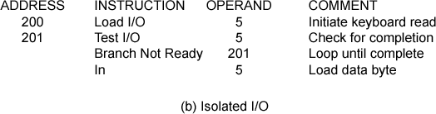
Memory Mapped and Isolated I/O

Slide 19
Interrupt Driven I/O
Overcomes CPU waiting
No repeated CPU checking of device
I/O module interrupts when ready

Slide 20
Interrupt Driven I/O Basic Operation
CPU issues read command
I/O module gets data from peripheral whilst CPU does other work
I/O module interrupts CPU
CPU requests data
I/O module transfers data

Slide 21
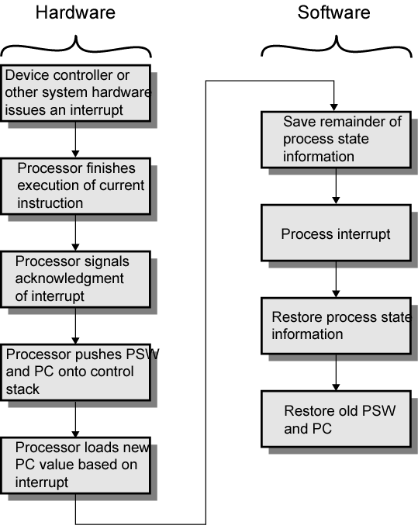
Simple Interrupt Processing

Slide 22
CPU Viewpoint
Issue read command
Do other work
Check for interrupt at end of each instruction cycle
If interrupted:-
—Save context (registers)
—Process interrupt
– Fetch data & store

Slide 23
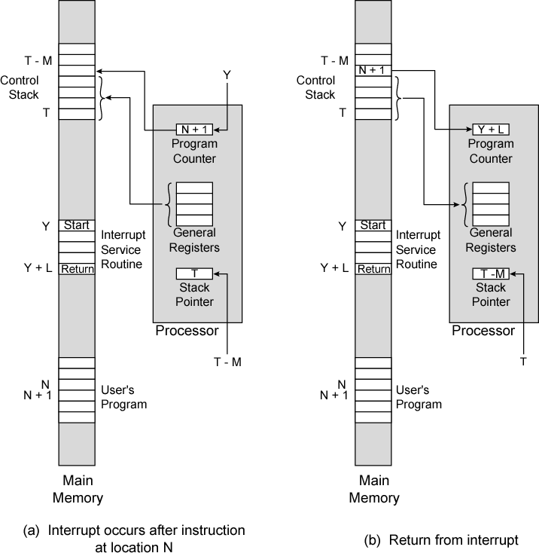
Changes in Memory and Registers for an Interrupt

Slide 24
Design Issues
How do you identify the module issuing the interrupt?
How do you deal with multiple interrupts?
—i.e. an interrupt handler being interrupted

Slide 25
Identifying Interrupting Module (1)
Different line for each module
—PC
—Limits number of devices
Software poll
—CPU asks each module in turn
—Slow

Slide 26
Identifying Interrupting Module (2)
Daisy Chain or Hardware poll
—Interrupt Acknowledge sent down a chain
—Module responsible places vector on bus
—CPU uses vector to identify handler routine
Bus Master
—Module must claim the bus before it can raise interrupt
—e.g. PCI & SCSI

Slide 27
Multiple Interrupts
Each interrupt line has a priority
Higher priority lines can interrupt lower priority lines
If bus mastering only current master can interrupt

Slide 28
Example - PC Bus
80x86 has one interrupt line
8086 based systems use one 8259A interrupt controller
8259A has 8 interrupt lines

Slide 29
Sequence of Events
8259A accepts interrupts
8259A determines priority
8259A signals 8086 (raises INTR line)
CPU Acknowledges
8259A puts correct vector on data bus
CPU processes interrupt

Slide 30
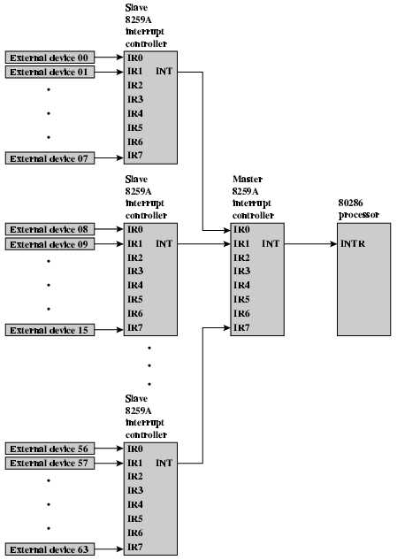
82C59A Interrupt Controller

Slide 31
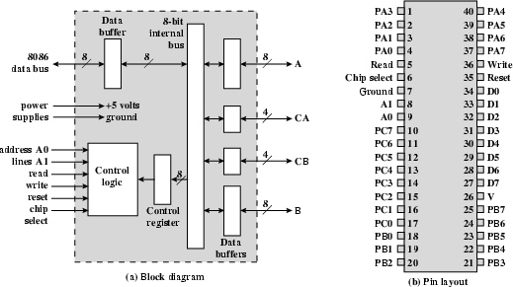
Intel 82C55A
Programmable Peripheral Interface

Slide 32
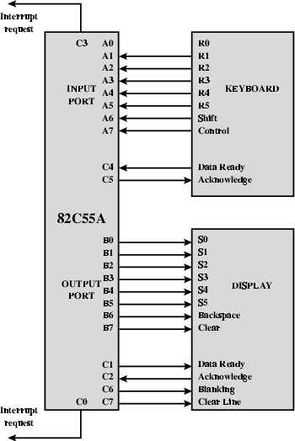
Keyboard/Display Interfaces to 82C55A

Slide 33
Direct Memory Access
Interrupt driven and programmed I/O require active CPU intervention
—Transfer rate is limited
—CPU is tied up
DMA is the answer

Slide 34
DMA Function
Additional Module (hardware) on bus
DMA controller takes over from CPU for I/O

Slide 35
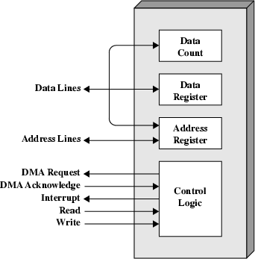
Typical DMA Module Diagram

Slide 36
DMA Operation
CPU tells DMA controller:-
—Read/Write
—Device address
—Starting address of memory block for data
—Amount of data to be transferred
CPU carries on with other work
DMA controller deals with transfer
DMA controller sends interrupt when finished

Slide 37
DMA Transfer Cycle Stealing
DMA controller takes over bus for a cycle
Transfer of one word of data
Not an interrupt
—CPU does not switch context
CPU suspended just before it accesses bus
—i.e. before an operand or data fetch or a data write
Slows down CPU but not as much as CPU doing transfer

Slide 38
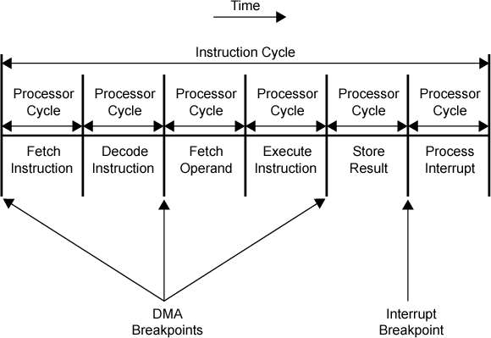
DMA and Interrupt Breakpoints During an Instruction Cycle

Slide 39
Aside
What effect does caching memory have on DMA?
What about on board cache?
Hint: how much are the system buses available?

Slide 40

DMA Configurations (1)
Single Bus, Detached DMA controller
Each transfer uses bus twice
—I/O to DMA then DMA to memory
CPU is suspended twice

Slide 41
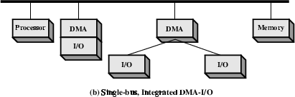
DMA Configurations (2)
Single Bus, Integrated DMA controller
Controller may support >1 device
Each transfer uses bus once
—DMA to memory
CPU is suspended once

Slide 42
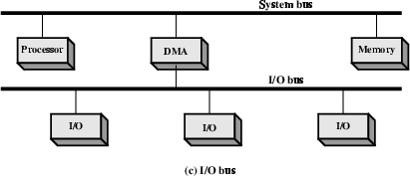
DMA Configurations (3)
Separate I/O Bus
Bus supports all DMA enabled devices
Each transfer uses bus once
—DMA to memory
CPU is suspended once

Slide 43
Intel 8237A DMA Controller
•
•
Interfaces to 80x86 family and DRAM
When DMA module needs buses it sends HOLD signal to processor
CPU responds HLDA (hold acknowledge)
— DMA module can use buses
E.g. transfer data from memory to disk
•
•
Device requests service of DMA by pulling DREQ (DMA request) high
DMA puts high on HRQ (hold request),
CPU finishes present bus cycle (not necessarily present instruction) and puts high on HDLA (hold acknowledge). HOLD remains active for duration of DMA
DMA activates DACK (DMA acknowledge), telling device to start transfer
DMA starts transfer by putting address of first byte on address bus and activating MEMR; it then activates IOW to write to peripheral. DMA decrements counter and increments address pointer. Repeat until count reaches zero
DMA deactivates HRQ, giving bus back to CPU

Slide 44
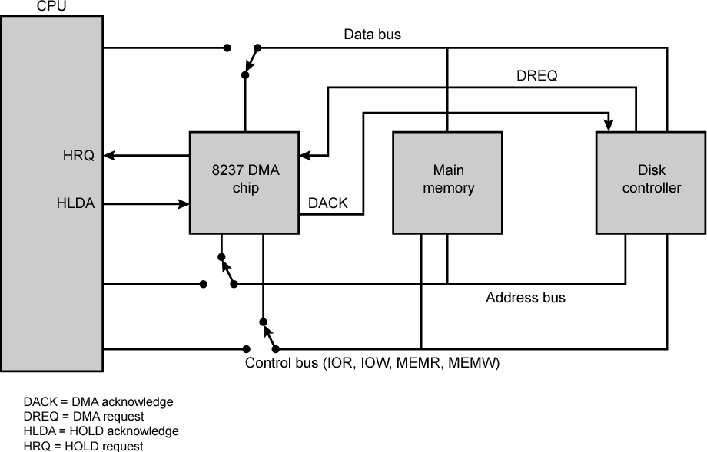
8237 DMA Usage of Systems Bus

Slide 45
Fly-By
While DMA using buses processor idle
Processor using bus, DMA idle
—Known as fly-by DMA controller
Data does not pass through and is not stored in DMA chip
—DMA only between I/O port and memory
—Not between two I/O ports or two memory locations
Can do memory to memory via register
8237 contains four DMA channels
—Programmed independently
—Any one active
—Numbered 0, 1, 2, and 3

Slide 46
I/O Channels
I/O devices getting more sophisticated
e.g. 3D graphics cards
CPU instructs I/O controller to do transfer
I/O controller does entire transfer
Improves speed
—Takes load off CPU
—Dedicated processor is faster

Slide 47
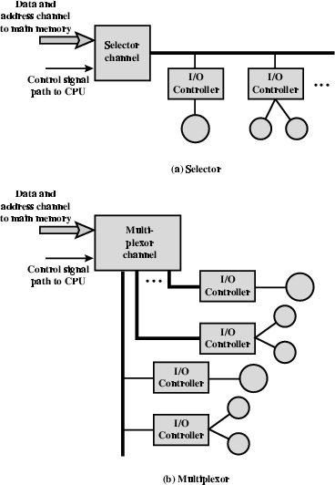
I/O Channel Architecture

Slide 48
Interfacing
Connecting devices together
Bit of wire?
Dedicated processor/memory/buses?
E.g. FireWire, InfiniBand

Slide 49
IEEE 1394 FireWire
High performance serial bus
Fast
Low cost
Easy to implement
Also being used in digital cameras, VCRs and TV

Slide 50
FireWire Configuration
Daisy chain
Up to 63 devices on single port
—Really 64 of which one is the interface itself
Up to 1022 buses can be connected with bridges
Automatic configuration
No bus terminators
May be tree structure

Slide 51
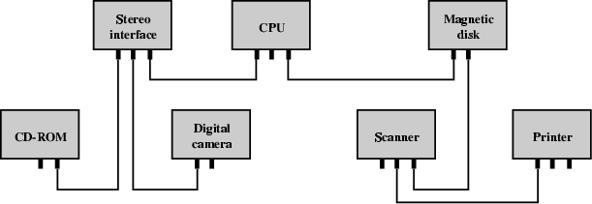
Simple FireWire Configuration

Slide 52
FireWire 3 Layer Stack
Physical
—Transmission medium, electrical and signaling characteristics
Link
—Transmission of data in packets
Transaction
—Request-response protocol

Slide 53
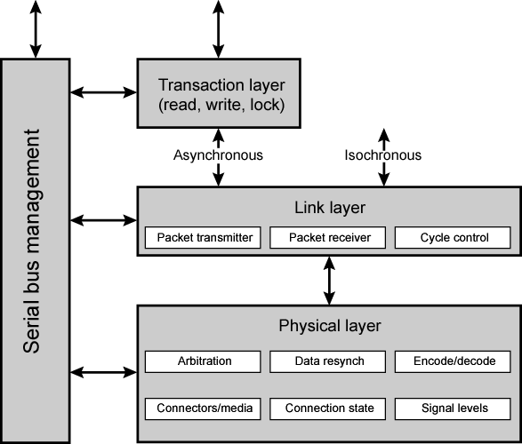
FireWire Protocol Stack

Slide 54
FireWire - Physical Layer
Data rates from 25 to 400Mbps
Two forms of arbitration
—Based on tree structure
—Root acts as arbiter
—First come first served
—Natural priority controls simultaneous requests
– i.e. who is nearest to root
—Fair arbitration
—Urgent arbitration

Slide 55
FireWire - Link Layer
Two transmission types
—Asynchronous
Variable amount of data and several bytes of transaction data transferred as a packet
To explicit address
Acknowledgement returned
—Isochronous
Variable amount of data in sequence of fixed size packets at regular intervals
Simplified addressing
No acknowledgement

Slide 56
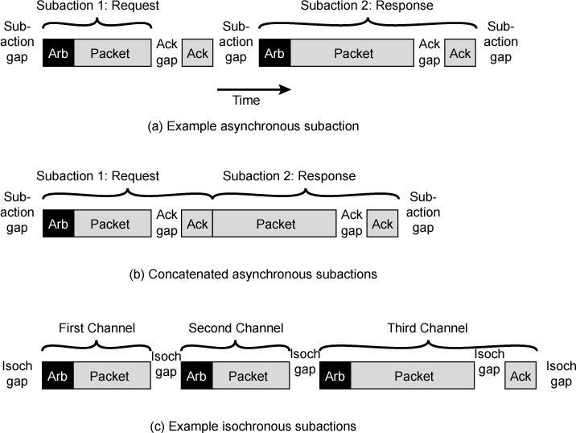
FireWire Subactions

Slide 57
InfiniBand
I/O specification aimed at high end servers
—Merger of Future I/O (Cisco, HP, Compaq, IBM) and Next Generation I/O (Intel)
Version 1 released early 2001
Architecture and spec. for data flow between processor and intelligent I/O devices
Intended to replace PCI in servers
Increased capacity, expandability, flexibility

Slide 58
InfiniBand Architecture
Remote storage, networking and connection between servers
Attach servers, remote storage, network devices to central fabric of switches and links
Greater server density
Scalable data centre
Independent nodes added as required
I/O distance from server up to
— 17m using copper
— 300m multimode fibre optic
— 10km single mode fibre
Up to 30Gbps

Slide 59
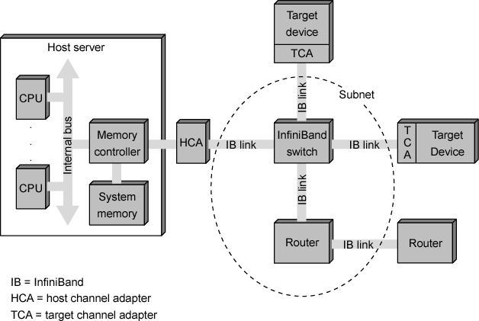
InfiniBand Switch Fabric

Slide 60
InfiniBand Operation
16 logical channels (virtual lanes) per physical link
One lane for management, rest for data
Data in stream of packets
Virtual lane dedicated temporarily to end to end transfer
Switch maps traffic from incoming to outgoing lane

Slide 61
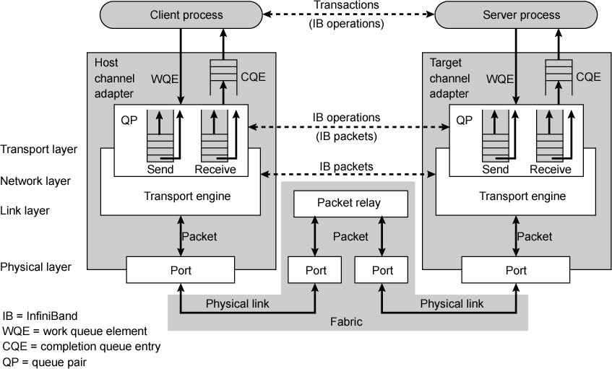
InfiniBand Protocol Stack

Slide 62
Connecting
All the units must be connected
Different type of connection for different type of unit
—Memory
—Input/Output
—CPU

Slide 63
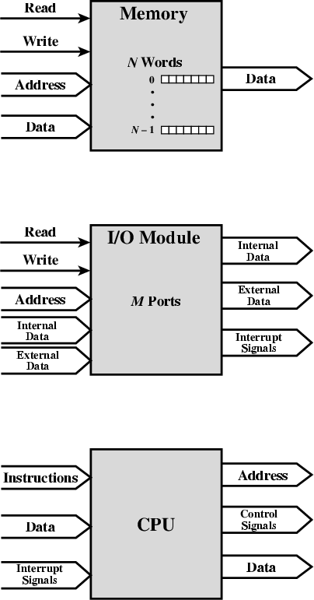
Computer Modules

Slide 64
Memory Connection
Receives and sends data
Receives addresses (of locations)
Receives control signals
—Read
—Write
—Timing

Slide 65
Input/Output Connection(1)
Similar to memory from computer’s viewpoint
Output
—Receive data from computer
—Send data to peripheral
Input
—Receive data from peripheral
—Send data to computer

Slide 66
Input/Output Connection(2)
Receive control signals from computer
Send control signals to peripherals
—e.g. spin disk
Receive addresses from computer
—e.g. port number to identify peripheral
Send interrupt signals (control)

Slide 67
CPU Connection
Reads instruction and data
Writes out data (after processing)
Sends control signals to other units
Receives (& acts on) interrupts

Slide 68
Buses
There are a number of possible interconnection systems
Single and multiple BUS structures are most common
e.g. Control/Address/Data bus (PC)
e.g. Unibus (DEC-PDP)

Slide 69
What is a Bus?
A communication pathway connecting two or more devices
Usually broadcast
Often grouped
—A number of channels in one bus
—e.g. 32 bit data bus is 32 separate single bit channels
Power lines may not be shown

Slide 70
Data Bus
Carries data
—Remember that there is no difference between “data” and “instruction” at this level
Width is a key determinant of performance
—8, 16, 32, 64 bit

Slide 71
Address bus
Identify the source or destination of data
e.g. CPU needs to read an instruction (data) from a given location in memory
Bus width determines maximum memory capacity of system
—e.g. 8080 has 16 bit address bus giving 64k address space

Slide 72
Control Bus
Control and timing information
—Memory read/write signal
—Interrupt request
—Clock signals

Slide 73
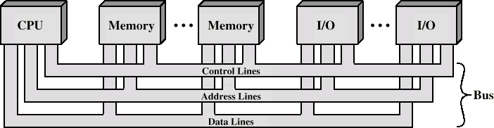
Bus Interconnection Scheme

Slide 74
Big and Yellow?
What do buses look like?
—Parallel lines on circuit boards
—Ribbon cables
—Strip connectors on mother boards
– e.g. PCI
—Sets of wires

Slide 75
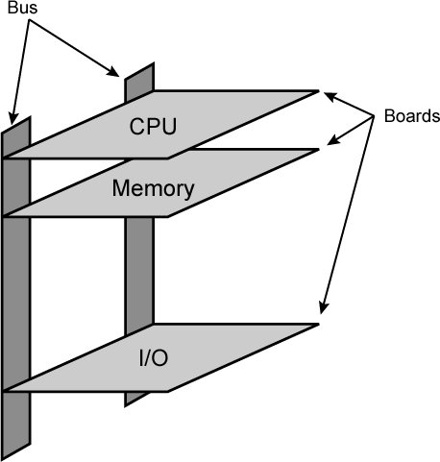
Physical Realization of Bus Architecture

Slide 76
Single Bus Problems
Lots of devices on one bus leads to:
—Propagation delays
Long data paths mean that co-ordination of bus use can adversely affect performance
If aggregate data transfer approaches bus capacity
Most systems use multiple buses to overcome these problems

Slide 77
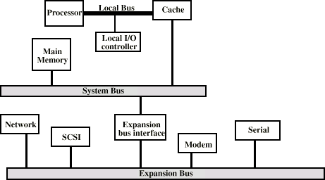
Traditional (ISA) (with cache)

Slide 78
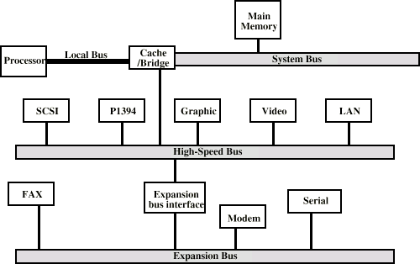
High Performance Bus

Slide 79
Bus Types
Dedicated
—Separate data & address lines
Multiplexed
—Shared lines
—Address valid or data valid control line
—Advantage - fewer lines
—Disadvantages
More complex control
Ultimate performance

Slide 80
Bus Arbitration
More than one module controlling the bus
e.g. CPU and DMA controller
Only one module may control bus at one time
Arbitration may be centralised or distributed

Slide 81
Centralised or Distributed Arbitration
Centralised
—Single hardware device controlling bus access
Bus Controller
Arbiter
—May be part of CPU or separate
Distributed
—Each module may claim the bus
—Control logic on all modules

Slide 82
Timing
Co-ordination of events on bus
Synchronous
—Events determined by clock signals
—Control Bus includes clock line
—A single 1-0 is a bus cycle
—All devices can read clock line
—Usually sync on leading edge
—Usually a single cycle for an event

Slide 83
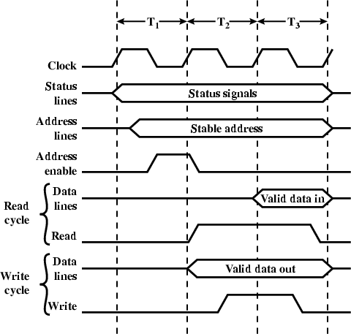
Synchronous Timing Diagram

Slide 84
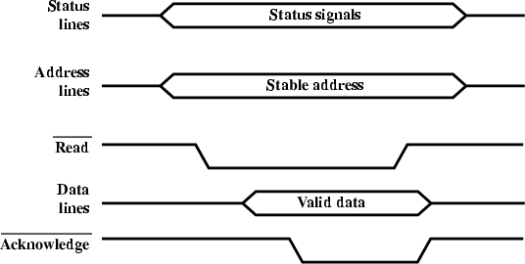
Asynchronous Timing – Read Diagram

Slide 85
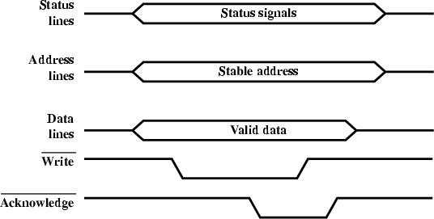
Asynchronous Timing – Write Diagram

Slide 86
PCI Bus
Peripheral Component Interconnection
Intel released to public domain
32 or 64 bit
50 lines

Slide 87
PCI Bus Lines (required)
Systems lines
—Including clock and reset
Address & Data
—32 time mux lines for address/data
—Interrupt & validate lines
Interface Control
Arbitration
—Not shared
—Direct connection to PCI bus arbiter
Error lines

Slide 88
PCI Bus Lines (Optional)
Interrupt lines
—Not shared
Cache support
64-bit Bus Extension
—Additional 32 lines
—Time multiplexed
—2 lines to enable devices to agree to use 64-bit transfer
JTAG/Boundary Scan
—For testing procedures

Slide 89
PCI Commands
Transaction between initiator (master) and target
Master claims bus
Determine type of transaction
—e.g. I/O read/write
Address phase
One or more data phases

Slide 90
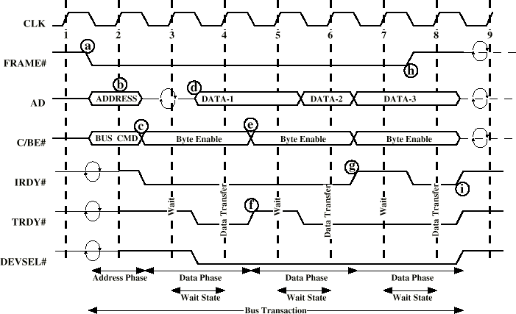
PCI Read Timing Diagram

Slide 91
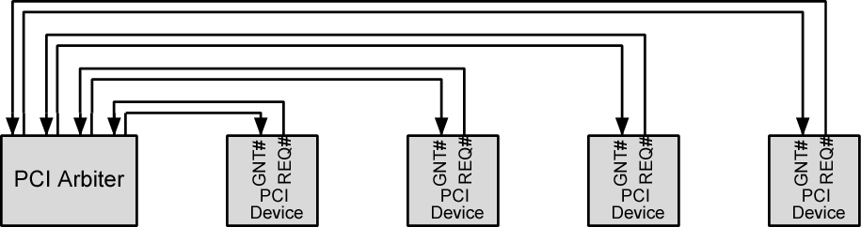
PCI Bus Arbiter

Slide 92
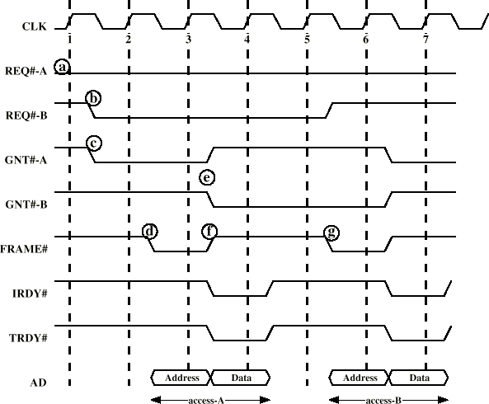
PCI Bus Arbitration

Slide 93
Required Reading
Stallings chapter 7 and 3
Stallings, W. [2004] Operating Systems, Pearson
Loads of Web sites on Operating Systems
www.pcguide.com/ref/mbsys/buses/
In fact, read the whole site!
www.pcguide.com/

